Slide 1



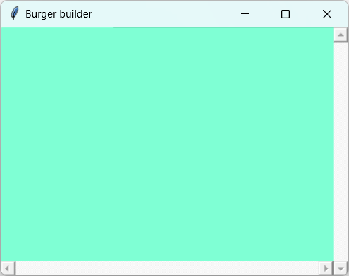
Tcltk : : CHEAT SHEET and moderate-complexity GUI example (1/3)
Introduction
Geometry managers
Tcltk is the R implementation of the Tcl/Tk toolkit for creating GUIs. The GUIs have customizable widgets to gather inputs from the user and return them for use later by R script.
(Tk is a package for creating GUI widgets, and it runs on the programming language Tcl, or Tool Command Language.) Tcl/Tk is cross-platform and has implementations in other programming languages like tkinter (“Tk interface”) in Python. Tcl/Tk is quite old, and for R, people have largely moved on to alternatives like Shiny. This cheat sheet is for people who have found a reason to still use Tcl/Tk in R.
library(tcltk2) # tcltk is a base package in R but tcltk2 is not.
library(dplyr)
library(stringr)
You must apply a geometry manager like Tkpack to a widget in order for it to appear
With Tkpack, you specify side (top/bottom/left/right), anchor (n, e, sw, etc.), fill (x/y/both), and expand (T/F). Packing is easiest for quickly arranging a few widgets. More complex geometries can be achieved by packing widgets into frames and frames into other frames.
The other geometry managers are tkgrid (to be used later) and tkplace (rarely used)
You can only have one geometry manager per parent (E.g., you cannot mix widgets with tkpack and tkgrid inside of the same frame)
tkpack(scr, side = "right", fill = "y", expand = F)
tkpack(xscr, side = "bottom", fill = "x", expand = F)
tkpack(cnv, side = "bottom", fill = "both", expand = T)
Base, canvas and frame
Remember to run install.packages("tcltk2").
A few of its features are used in this example.
base <- tktoplevel() # This makes a new window appear on your screen
tkwm.title(base, "Burger builder")
tkwm.geometry(base, "+50+50" ) # Specify the position within your screen
Canvases and frames are areas that can hold widgets inside of them. This canvas cnv has base as its parent, so it will go inside of base. The frame fme has cnv as its parent, and fme will be parent to other widgets later.
cnv <- tkcanvas(base)
fme <- tkframe(cnv)
tkconfigure
Use tkconfigure to change the options for a widget after it's already been created.
tkconfigure(fme, background = "wheat")
tkconfigure(cnv, background = "aquamarine")
fme is not visible below because no widgets have been added into it yet.
Making a canvas scrollable
Canvases have a few more features than frames, including being scrollable. If just for holding widgets, we usually use frames. The code below is complicated; just know that it makes the canvas scrollable.
scr <- tkscrollbar(base, repeatinterval = 5,
orient = "vertical", command = function(...) tkyview(cnv,...))
xscr <- tkscrollbar(base, repeatinterval = 5,
orient = "horizontal", command = function(...) tkxview(cnv,...))
tkconfigure(cnv, yscrollcommand = function(...) tkset(scr,...),
xscrollcommand = function(...) tkset(xscr, ...))
tkbind(base, "<MouseWheel>", function(...) tkyview(cnv,...)) # Bind the
mouse wheel to the scroll function
scrollform_resize <- function(frm) {
canvport <- tkwinfo("parent", frm)
bbox <- tkbbox(canvport, "all")
w <- tkwinfo("width", frm)
tkconfigure(canvport, width = w, scrollregion = bbox,
yscrollincrement = "0.1i")
}
tkbind(fme, "<Configure>", function () scrollform_resize(fme))
tkcreate(cnv, "window", 0, 0, anchor = "nw", window = fme)
Additional resources on Tcl/Tk
tcltk2 package documentation
A Primer on the R-Tcl/Tk Package by Peter Dalgaard
Tcl/Tk Reference Guide, not specific to the R package
CC BY SA Dan Sui • dansui000 [at] gmail [dot] com • tcltk2 package version 1.2-11 • Cheat sheet updated: 2023-12

Slide 2
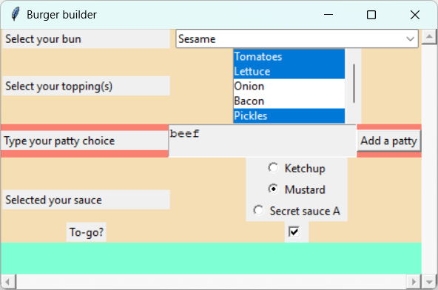
Tcltk : : CHEAT SHEET and moderate-complexity GUI example (2/3)
Widgets w/ control variables
Buttons
Label (to display text)
lbl_bun <- tklabel(fme, text = "Select your bun", width = 25, anchor = "w")
lbl_topping <- tklabel(fme, text = "Select your topping(s)", width = 25, anchor = "w")
lbl_sauce <- tklabel(fme, text = "Selected your sauce", width = 25, anchor = "w")
lbl_togo <- tklabel(fme, text = "To-go?")
Geometry managers – Tkgrid
Tkgrid is the other geometry manager. You specify which row/column a widget will appear in, as if the frame
were a table. This makes large numbers of widgets easier to align.
tkgrid(lbl_bun, row = 1, column = 1)
tkgrid(lbl_topping, row = 2, column = 1)
tkgrid(lbl_sauce, row = 4, column = 1, rowspan = 4)
tkgrid(lbl_togo, row = 7, column = 1) # (Rows 3, 5 and 6 will be used later)
Combobox (drop-down list)
options_for_bun <- c("Classic", "Sesame", "Whole wheat", "Gluten-free")
var_bun <- tclVar("Sesame") # Choose the default here
cmb_bun <- tk2combobox(fme, width = 40, values = options_for_bun, textvariable = var_bun)
Most widgets can be assigned a control variable (like textvariable above) that holds the selected value. You can get the value of the variable (e.g., with tclvalue(var_bun)) even after the GUI is closed.
tkgrid(cmb_bun, row = 1, column = 2)
Checkbutton (Checkbox)
var_togo <- tclVar(FALSE) # Control variable
chk_togo <- tkcheckbutton(fme, variable = var_togo)
tkgrid(chk_togo, row = 7, column = 2)
tktoggle(chk_togo) # You can check/uncheck the box programatically
Define a function to run when the user clicks "Add a patty“.
on_add_patty <- function(){
# First, get how many patties are already there
size_of_existing_tkgrid <- fme_patty %>% tkgrid.size() %>%
tclvalue() %>% strsplit(" ") %>% unlist() %>% as.numeric()
n <- size_of_existing_tkgrid[2] # tkgrid.size() returns (cols+1 , rows+1)
txts_patty[[n]] <- tktext(fme_patty, height = 2, width = 25) # Add new patty
tkinsert(txts_patty[[n]], "0.0", paste0("beef", n)) # Add default text
tkgrid(txts_patty[[n]], row = n, column = 2)
}
btn_add_patty <- tkbutton(fme_patty, text = "Add a patty",
command = on_add_patty)
tkgrid(btn_add_patty, row = 1, column = 3)
Widgets w/ control variables – Radiobutton
Each radiobutton is a separate widget, but we assign them all the same control variable.
var_sauce <- tclVar("Mustard")
rbn_ketchup <- tkradiobutton(fme, variable = var_sauce, text = "Ketchup",
value = "Ketchup", width = 12)
rbn_mustard <- tkradiobutton(fme, variable = var_sauce, text = "Mustard",
value = "Mustard", width = 12)
rbn_ssa <- tkradiobutton(fme, variable = var_sauce, text = "Secret sauce A",
value = "Relish", width = 12)
tkgrid(rbn_ketchup, row = 4, column = 2)
tkgrid(rbn_mustard, row = 5, column = 2)
tkgrid(rbn_ssa, row = 6, column = 2)
1a
1b
1f
1c
Widgets w/o control variables
1g
1d
Listbox (Multiple select)
Note that listboxes and text boxes do not have control variables. See later for how to get their values.
options_for_topping <- c("Tomatoes", "Lettuce", "Onion", "Bacon", "Pickles", "Pineapple")
lbx_topping <- tk2listbox(fme, values = options_for_topping, selectmode = c("multiple"))
tkgrid(lbx_topping, row = 2, column = 2)
lapply(c(0,1,4), function(x) tkselection.set(lbx_topping, x)) # Activate some default selections
Text (Text box for typing)
Advanced: We are going to allow the user to add new text boxes by clicking a button.
fme_patty <- tkframe(fme, background = "salmon") # A frame to help organize the patty-related widgets
tkgrid(fme_patty, row = 3, column = 1, columnspan = 2)
lbl_patty <- tklabel(fme_patty, text = "Type your patty choice", width = 25, anchor = "w")
tkgrid(lbl_patty, row = 1, column = 1)
txts_patty <- list() # The text boxes will be stored in a list (each one will be anonymous)
But create the first box automatically here:
txts_patty[[1]] <- tktext(fme_patty, height = 2, width = 25)
tkinsert(txts_patty[[1]], "0.0", "beef") # Add text to the text box
tkgrid(txts_patty[[1]], row = 1, column = 2)
1b
1d
1a
1f
1e
1e
1g
1c
CC BY SA Dan Sui • dansui000 [at] gmail [dot] com • tcltk2 package version 1.2-11 • Cheat sheet updated: 2023-12

Slide 3
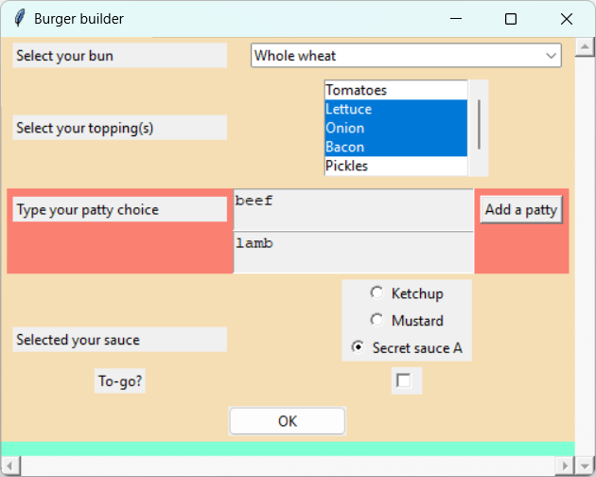
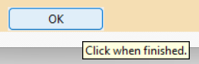

Tcltk : : CHEAT SHEET and moderate-complexity GUI example (3/3)
Buttons – An OK button
Retrieving and using the values
As noted above, some widgets like text (the patties) and listbox (the toppings) don't have control variables. So, you have to get the values from the widgets manually. Here we do so inside the function on_ok(), which is triggered when the user clicks OK.
The values can be saved to tclArray objects, so that they can be passed out of on_ok() without using global variables.
var_patty <- tclArray()
var_selected_values_for_topping <- tclArray()
on_ok <- function(){ # Activates when OK is clicked
# Get the values from the listbox (toppings)
var_selected_values_for_topping[[1]] <- tkcurselection(lbx_topping)
# Get the values from the text boxes (patties)
# Resort to referring to widgets by their locations in the tkgrid instead of by name
patties <- tkgrid.slaves(fme_patty, column = 2)
number_of_patties <- patties %>% tclvalue() %>% str_split(" ") %>% unlist() %>% length()
for (i in 1:number_of_patties){
patty <- tkget(tkgrid.slaves(fme_patty, row = i , column = 2), "1.0", "end-1c")
# This gets the text from beginning to end
var_patty[[i]] <- patty
}
tkdestroy(base) # Close the GUI
}
btn_ok <- tk2button(fme, text = "OK", width = 15, command = on_ok)
tkbind(base,"<Return>", on_ok) # Bind the Enter key to btn_ok
tkgrid(btn_ok, row = 8, column = 1, columnspan = 2)
Use this line to make the rest of your R script wait until the GUI is closed before running.
tkwait.window(base)
Remember that these widgets had control variables, so getting their values is straight-forward:
bun <- tclvalue(var_bun)
sauce <- tclvalue(var_sauce)
togo <- ifelse(tclvalue(var_togo) == "1", "to-go", "for here")
These widgets didn’t have control variables, so we saved their values in tclArray objects:
toppings_indexes <- var_selected_values_for_topping[[1]] %>%
tclvalue() %>% stringr::str_split(" ") %>% unlist() %>% as.numeric()
toppings <- options_for_topping [1 + toppings_indexes] %>%
paste(collapse = ", ") # Have to +1 because listbox uses 0-based indexing
number_of_patties <- length(var_patty)
patty <- list()
for (i in 1:number_of_patties) patty[[i]] <- tclvalue(var_patty[[i]])
patties <- paste(patty, collapse = ", ")
Now you can do something with the values.
print(paste("The order was a", patties, "burger", "with", toppings, "and",
sauce, "on a", bun, "bun", togo, sep = " "))
2a
[1] "The order was a beef, lamb burger with Lettuce, Onion, Bacon and Relish on a Whole wheat bun for here"
Additional
Some additional widgets that you can use. Check tcltk documentation for more.
# tkscale (fme, variable = var_x) for a sliding scale
# tkentry (fme, textvariable = var_y) for one single line of text
# textttkspinbox (fme, from = -5, to = 5, textvariable = var_z) for a spinbox
Use tkgrid.configure to change the tkgrid options for an already-gridded widget.
for (widget in list(lbl_bun, cmb_bun, lbl_topping, lbx_topping, fme_patty,
lbl_patty, btn_add_patty, lbl_sauce, lbl_togo, chk_togo, btn_ok)) {
tkgrid.configure (widget, padx = 5, pady = 5) }
Miscellaneous
# tk2tip(btn_ok, message = "Click when finished.") to add tooltips to help users
# tkcget(lbl_patty, "-text") %>% tclvalue() to get values of existing widget options
# tkmessageBox(title = "Greeting", message = "Hello") to make a pop-up box
# tkgetSaveFile(filetypes = "{ {Excel} {*.xlsx} }", defaultextension = ".xlsx") %>% tclvalue() to ask the user to specify a save file
2a
CC BY SA Dan Sui • dansui000 [at] gmail [dot] com • tcltk2 package version 1.2-11 • Cheat sheet updated: 2023-12

